Slide 1
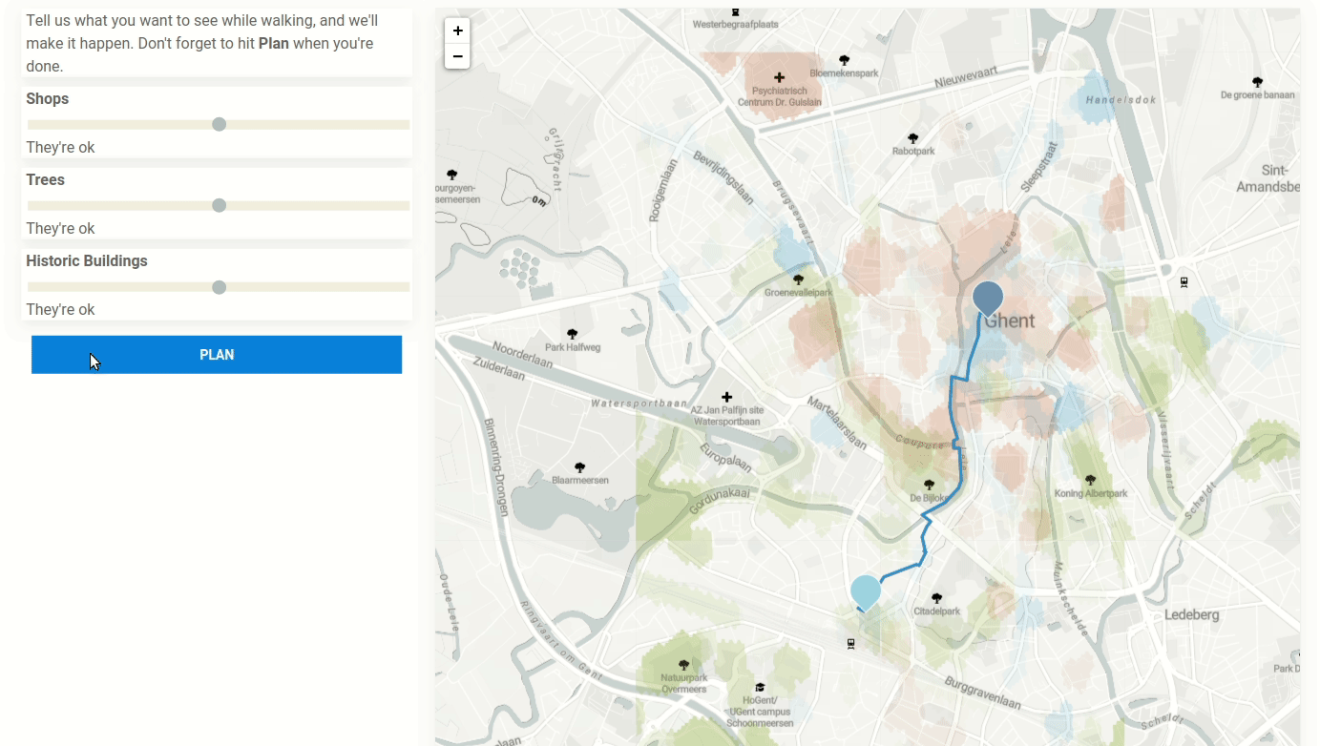
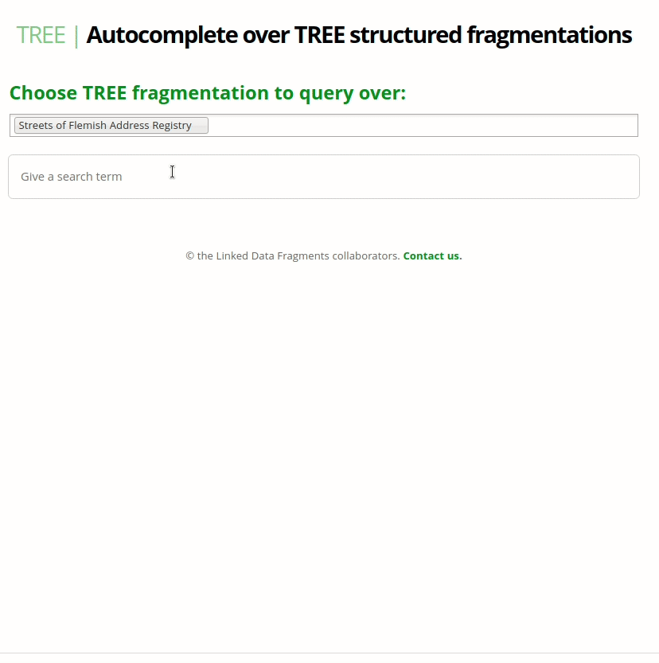
More structure Linked data
Route planning
Substring autocompletion
Interface align with the
domain of application?
http://hdelva.be/sem4tra2020/demo.html
Combination of:
Clustering of points of interest in OSM
Routable Tiles (Linked OSM PoC)
Weighted client-side route planning
Live demo at tree.linkeddatafragments.org

Slide 2

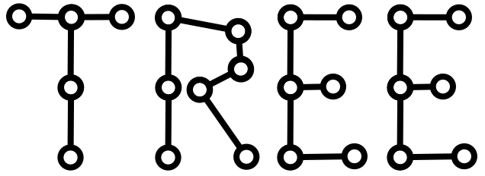

HOW TREE HYPERMEDIA CAN SPEED UP LINK TRAVERSAL-BASED QUERY PROCESSING FOR SPARQL QUERIES WITH FILTERS
Bryan-Elliott Tam

Slide 3
AGENDA
Context or the TREE specification
Formalisation
Benchmark
Future work

Slide 4
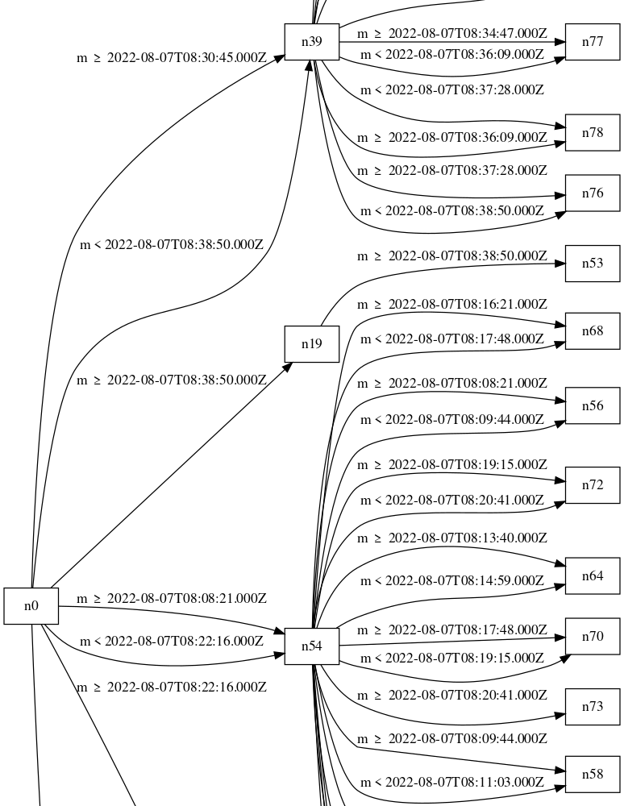
TREE specification
Fragmented database
  Graph
  Vertex/Node (tree:Node) are the data container
  Edge (tree:Relation) declare a constraint on the data inside a vertex
    The document can grow over time
    We don’t maintain a central index
    Link Traversal Query Processing to fetch the data
tree-document-topology-visualizer

Slide 5
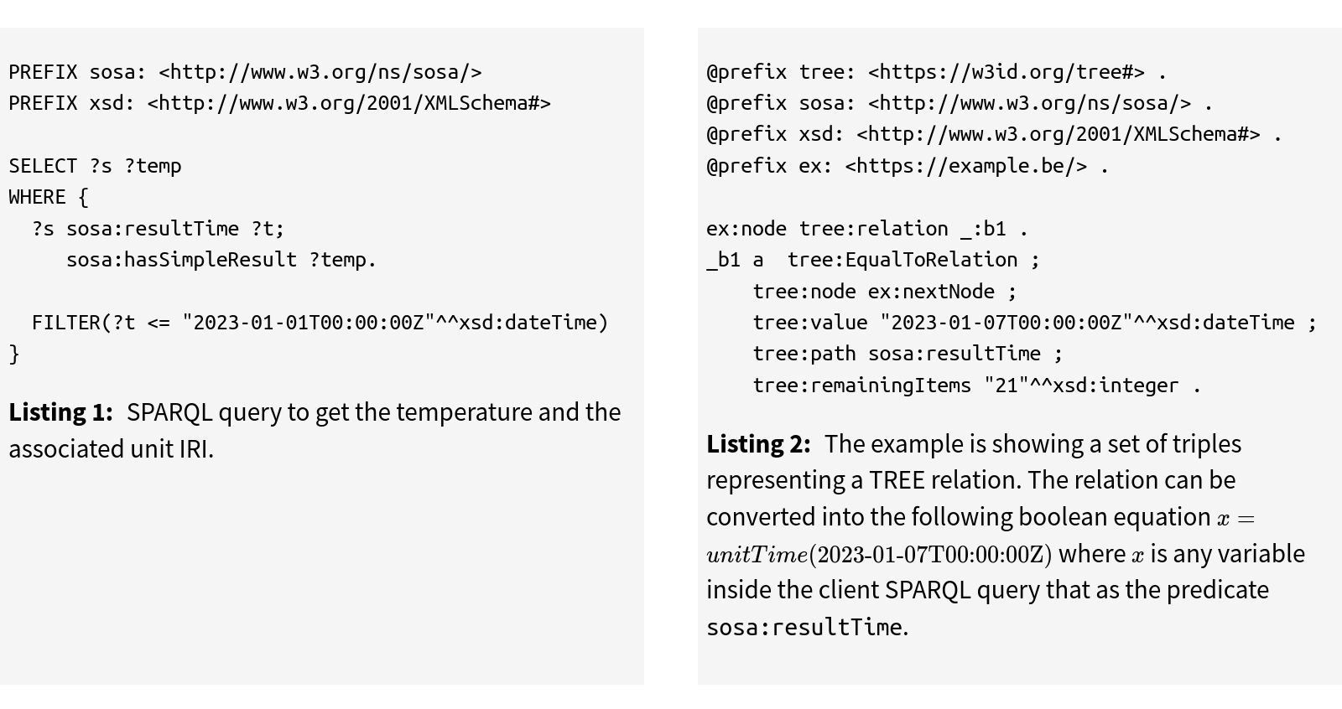
EXAMPLE USE CASE
Querying observations after the first of January
A solver will be needed to match a SPARQL query pattern to tree:Relations

Slide 6
How do we prune or prioritize relations based on a certain client’s input?
Client’s input: in our case this will be a SPARQL query

Slide 7
GUIDED LINK TRAVERSAL QUERY PROCESSING
    We take advantage of a priori knowledge or meta knowledge (understanding) for the choice of links
    Structure of a document
      Fragmented database
    Discovery of knowledge
      Relation

Slide 8
FORMALISATION

Slide 9
PROBLEM
  We have a boolean expression from the TREE Document and a boolean expression from the SPARQL filter
  We want to know if the combination of the two expression can be satisfy
  If so we follow the link

Slide 10
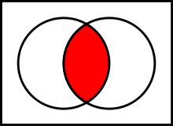

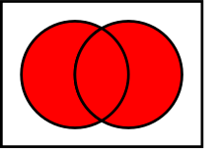

STRATEGY OF RESOLUTION
We calculate the domain of each sub expression and represent it as a set {lower bound, upper bound}
  Eg: x>5
  {5+dx, infinity}
  We concatenate the expression based on the boolean operator
    AND
    OR
    NOT
    The domain is a set of set containing the domain (subdomain) of each expression

Slide 11
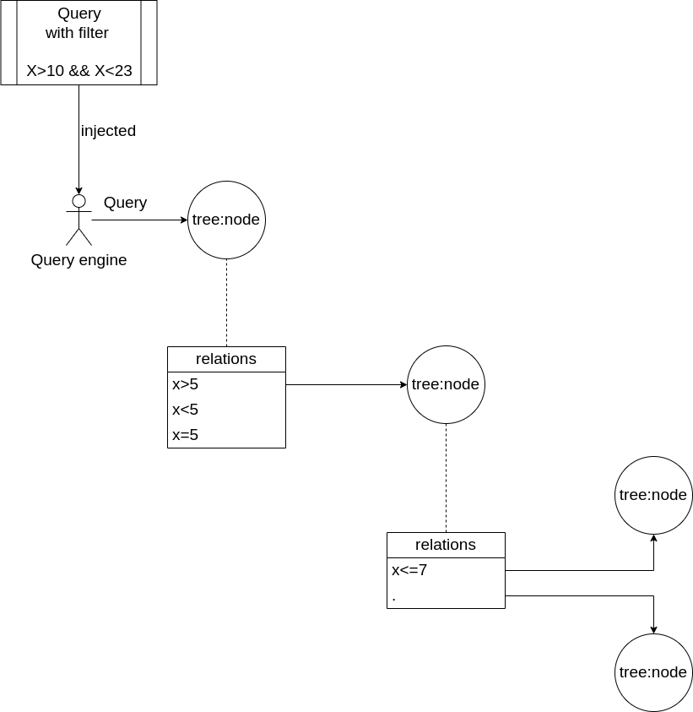

Slide 12
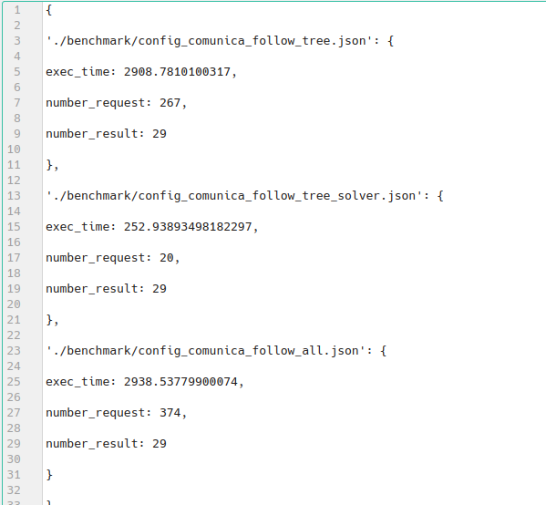
Testing query performance
Data: Time series, public transportation
Different topologies: B-tree, linked list, …
  Parameters
  Number of request
  Query execution time
  Number of results

Slide 13
Future work
  Benchmarking of query clients
  Better visualization tool
  Seeing which node we traversed
Support for string
View selection based on the query

